Slide 1

Electronic Conspicuity
Development in Europe
Bob Darby, AOPA UK
IAOPA World Assembly, Queenstown, New Zealand
March 2018
Notes:
I would like to tell you a story about Electronic Conspicuity in Europe – what has happened so far, what is happening now and the issues to be solved. The story is still unfolding and we don’t yet know exactly how it will end.
But before going into all that, I would just like to illustrate Electronic Conspicuity by comparing it to visual conspicuity.
The next sequence of slides runs automatically.
It is a simulation of something that I never want to see for real.
Please watch the screen very closely.

Slide 2
11.0 secs
1100 m

Slide 3
10.5 secs
1050 m

Slide 4
10 secs
1000 m

Slide 5
9.5 secs
950 m

Slide 6
9.0 secs
900 m

Slide 7
8.5 secs
850 m

Slide 8
8.0 secs
800 m

Slide 9
7.5 secs
750 m

Slide 10
7.0 secs
700 m

Slide 11
6.5 secs
650 m

Slide 12
6.0 secs
600 m

Slide 13
5.5 secs
550 m

Slide 14
5.0 secs
500 m

Slide 15
4.5 secs
450 m

Slide 16
4.0 secs
400 m

Slide 17
3.5 secs
350 m

Slide 18
3.0 secs
300 m

Slide 19
2.5 secs
250 m

Slide 20
2.0 secs
200 m

Slide 21

1.5 secs
150 m

Slide 22

1.0 secs
100 m

Slide 23
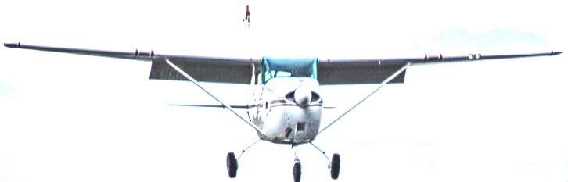
0.5 secs
50 m

Slide 25
Head on encounter simulation
Closing speed 200kts = approx 100m/sec
Wingspan about 10m
0.5 second interval between images
When did you start feeling uncomfortable?
I will run that again. Shout when uncomfortable!

Slide 26
11.0 secs
1100 m

Slide 27
10.5 secs
1050 m

Slide 28
10 secs
1000 m

Slide 29
9.5 secs
950 m

Slide 30
9.0 secs
900 m

Slide 31
8.5 secs
850 m

Slide 32
8.0 secs
800 m

Slide 33
7.5 secs
750 m

Slide 34
7.0 secs
700 m

Slide 35
6.5 secs
650 m

Slide 36
6.0 secs
600 m

Slide 37
5.5 secs
550 m

Slide 38
5.0 secs
500 m

Slide 39
4.5 secs
450 m

Slide 40
4.0 secs
400 m

Slide 41
3.5 secs
350 m

Slide 42
3.0 secs
300 m

Slide 43
2.5 secs
250 m

Slide 44
2.0 secs
200 m

Slide 45
1.5 secs
150 m

Slide 46
1.0 secs
100 m

Slide 47
0.5 secs
50 m

Slide 49
Encounter video
  Encounter.
  About 5 seconds after video start, aircraft appears in the middle of screen (just above the mark on glare shield) and crosses centre to upper left
  How close was it?
CPA: 150m. Relative height: 350ft above
Notes:
Was that uncomfortable? Probably not.
Why not? Seen in good enough time to assess the threat and react if necessary.
The critical factor is to SEE THE OTHER AIRCRAFT – not always very easy. Look at the following examples.

Slide 50
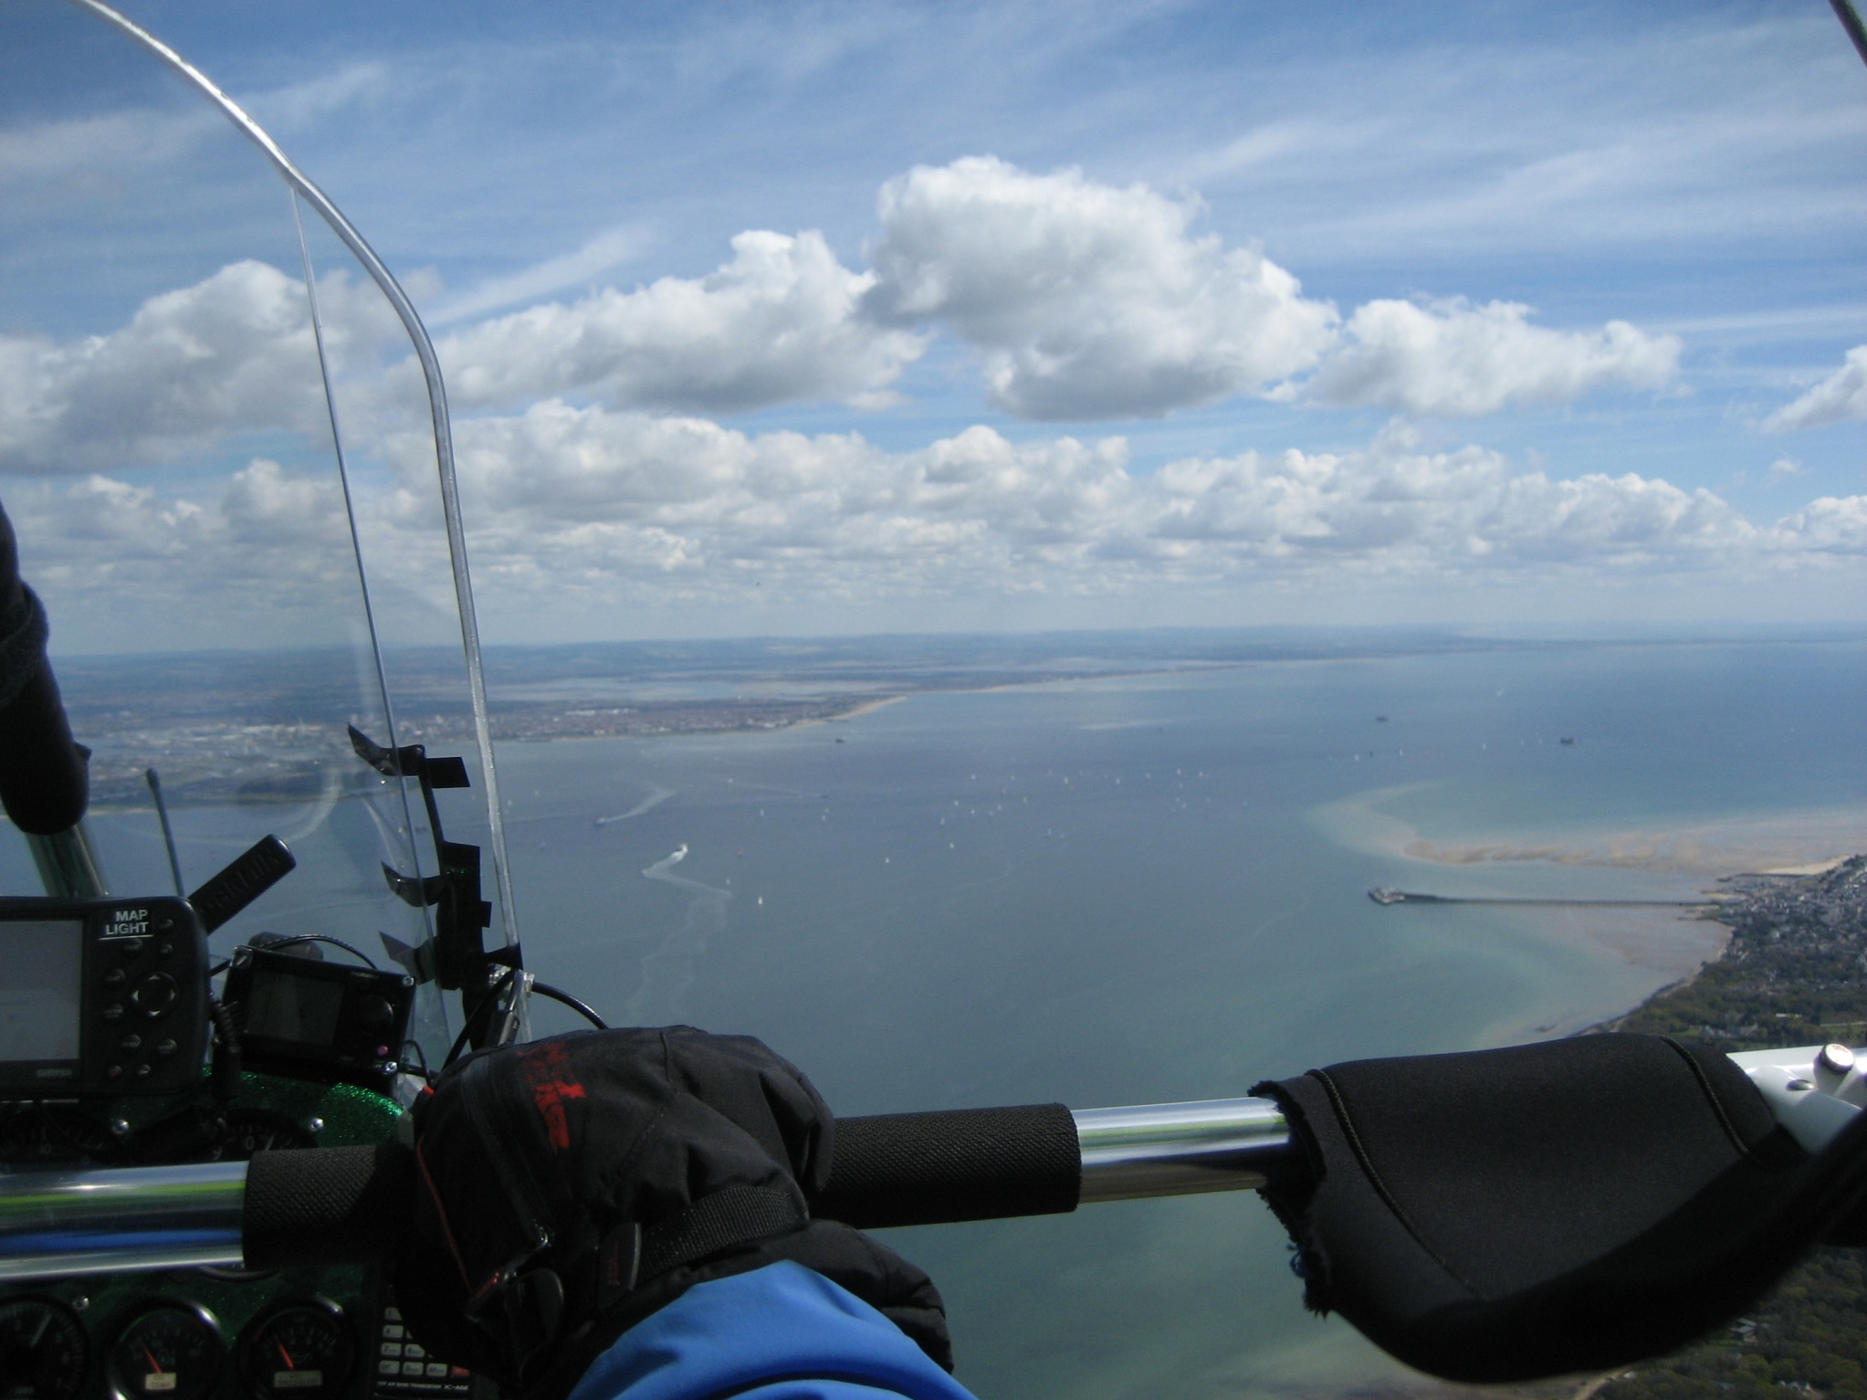
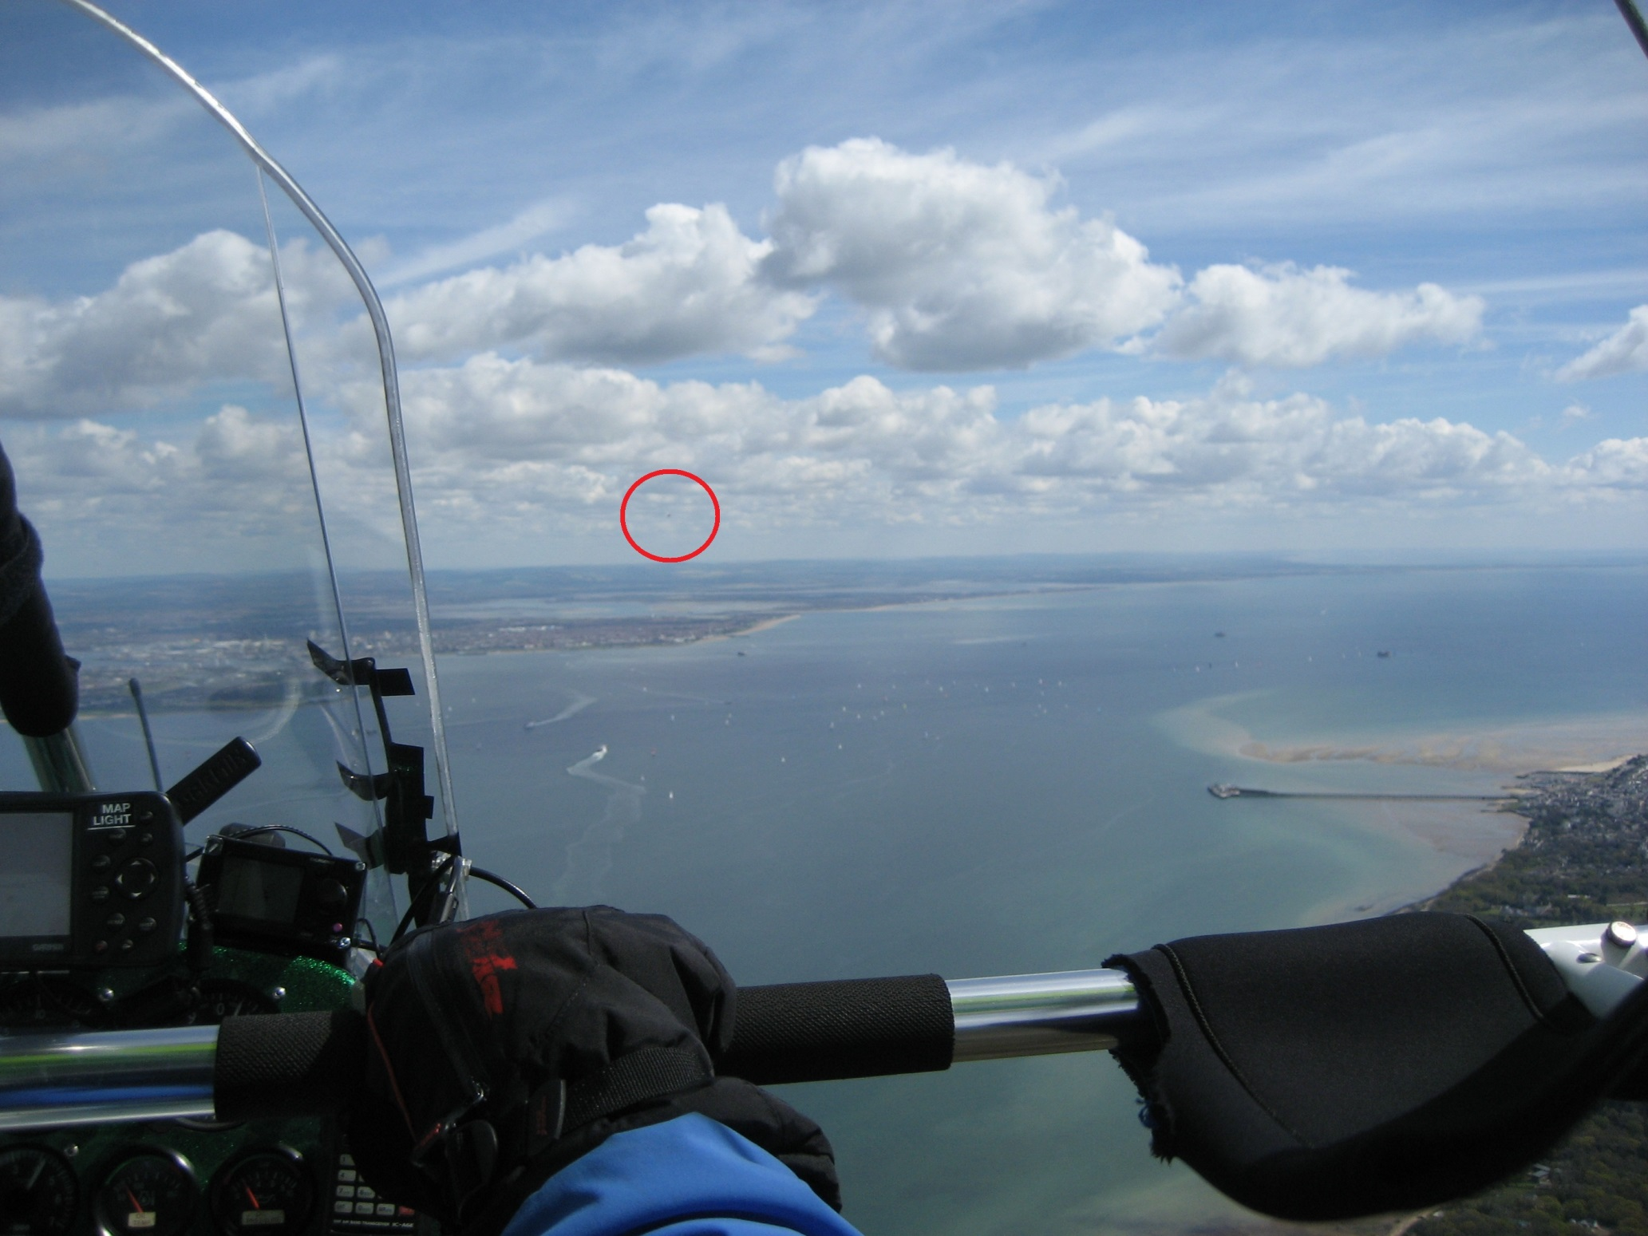
  Limitation of See & Avoid?
  Another QuikR Microlight is 0.66 NM away…
Notes:
Even when you know where to look, it can be really hard to see the other aircraft
Take a good look at this picture, which shows another QwikR at a similar height and 2/3rds of a NM distance, which equates to 20 seconds at combined flying speeds.
Can you see it yet?
_____________________________________
CLICK
---------------------------------------
So, a weightshift is still a speck in the sky at 2/3rds of a NM.

Slide 51

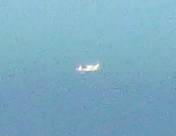
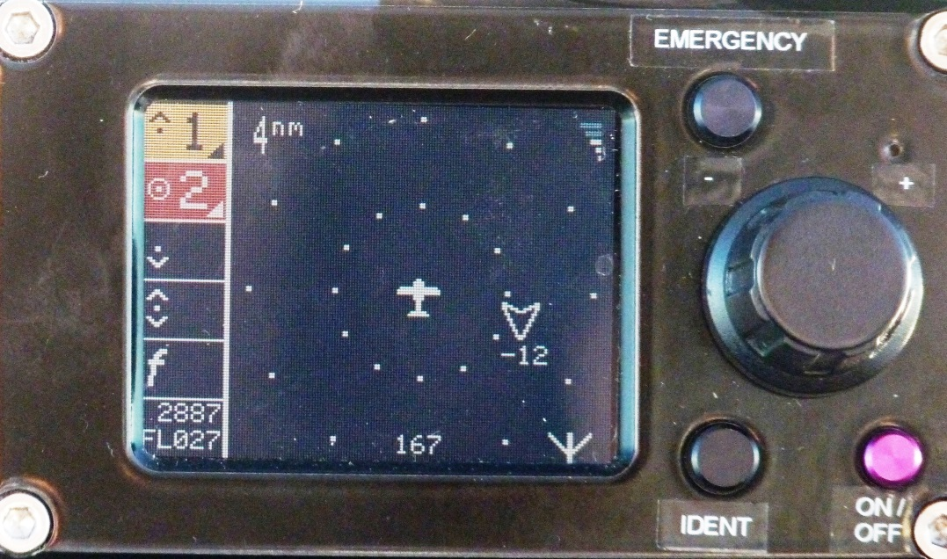
Easier example
Even easier using Electronic Conspicuity equipment
Notes:
This is from a flight that was part of the EVA Project. I will say more about that later.
EVA demonstrated the use of Electronic Conspicuity in GA aircraft.

Slide 52
Electronic Conspicuity is about seeing and BEING SEEN
“See and Avoid” becomes …
“See, BE SEEN and avoid” …
… to mitigate Mid Air Collision risk

Slide 53
Mid Air Collision risk in context
Mid Air Collision is 4th for fatal accidents in EASA NCO (aeroplanes) Safety Risk Portfolio (EASA Annual Safety Review 2016)
For MAC, the pilot has no control of the
most significant factor: the other aircraft+pilot
Key mitigation: help the other pilot see you
by carrying Electronic Conspicuity equipment.
Notes:
This statistic comes from the 2016 EASA safety review.
The top hazards are
Aircraft upset in flight
Terrain conflict
Engine Failure
Airborne conflict
But the only one of which the pilot has no control of the most significant factor is MAC.
This is where the best protection you can give yourself is to make it easier to BE SEEN.
I like the analogy of riding a bike at night without lights. You see the car lights – the cars see you only when they hit you!

Slide 54
Notes:
The idea so far has been to talk about visual conspicuity to put Electronic Conspicuity into context.
The message is that
See and avoid has limitations, some of which are:
visual acuity/ weather-cloud and haze/ view blocked by the airframe
E.g. Low wing a/c descending above high wing
See and avoid can be helped by technology.
ADS-B technology enables EC which enables “BE SEEN”
For me, the difference between Electronic Conspicuity and ADS-B is
ADS-B is the technology, including Tx and Rx
EC is the application of ADS-B-In & ADS-B-OUT
Benefit to pilot is to provide traffic awareness in the cockpit

Slide 55
ADS-B developments for GA
European and world-wide developments
UK initiatives
  LPAT
  EVA
  ECWG and CAP1391
GA equipment available now
Current European situation
  Project GAINS
  Coordination with UK CAA
  EASA EC Forum
Agreements and differences
Notes:
I should now warn you that I will hit you with a perfect storm of acronyms.
But this is aviation – you would be disappointed if I didn’t!
There is a list at the end in the distributed version of the slides.
What I will summarise are
Some UK AOPA and CAA initiatives
And a couple of projects and coordnation with UK CAA and EASA
There is a lot of text as a reminder for later but this is not “death by powerpoint”.

Slide 56
More than 20 years of European and world-wide development
Electronic Conspicuity based on ADS-B
ADS-B approximate dates
1992- 2002: Research and demonstration phase
ANC10 to ANC11 period
R&D in Europe (Eurocontrol, European Commission) and USA
Joint Europe/USA activities: Technical Link Assessment Team
ANC11. ICAO ADS-B datalink recommendation
  Mode S Extended Squitter 1090 MHz in common; UAT & VDL4 regional
2002 onwards: joint EUROCAE and RTCA standards development
WG51+SC186 Requirements Focus Group.
Assessed many ADS-B applications, both for ground and cockpit use
2009 onwards: mandates and infrastructure development
FAA Mandate from 2020. CAT and GA
European SPI-IR: similar content and date but neglects GA
Notes:
Won’t spend long on this, and you will have the slides afterwards.
Main points I would like to make are that
ADS-B has been in development for a long time.
But real focus on GA needs is much more recent – since the notion of mandatory equipage arose.
The attention now paid to GA , in Europe at least, is because Martin Robinson has continued to rattle the European cage for funding from the SESAR Programme.
As a result, we have completed one project and are starting another one. They both focus very much on affordable ADS-B for low-end GA.

Slide 57
UK Initiative 1: LPAT
NATS priority: reduce controlled airspace infringements
Make light aircraft more easily detected by ground surveillance
At less cost than transponder equipage
But how to encourage equipage?
Offer a benefit to the pilot
Cockpit visibility of other aircraft to help visual acquisition and reduce MAC
Achieved by Electronic Conspicuity
ADS-B-out coupled with ADS-B-in plus cockpit traffic display
NATS commissioned Low Power ADS-B Transceiver (LPAT) development by Funke Avionics. Transmits and receives 1090MHz ADS-B, so visible to ground equipment (for infringement detection, management and reduction) as well as to other aircraft. It can also in principle support a class G traffic service for GA.
Notes:
The LPAT idea came from NATS, who experience more than 1000 infringements into CAS each year. Pressure from the UK CAA is on NATS to reduce this.
NATS thinking was: to mitigate, manage and reduce infringements, there has to be a means to detect them but light GA pilots have resisted the expense of a transponder.
So , can NATS devise something cheaper?
How can they persuade pilots it is worth having?
The solution they came up with was to develop and trial the LPAT device that, as well as being detectable from the ground for infringement protection, can also be used in the cockpit to detect other aircraft. The benefits are:
To the pilot, awareness of other traffic
To the ground, detection of aircraft otherwise not seen.
And also on the ground, giving the possibility of ground detection of an impending conflict and warning the pilot.
This can support the traffic service that is offered to GA in class G airspace in many parts of the UK.

Slide 58
UK Initiative 2: Project EVA (2014-2016)
NATS + AOPA proposed EVA: Electronic Visibility by ADS-B https://www.nats.aero/projecteva/
Large Scale Demonstration supported by European SESAR Programme
Project EVA
More than 60 flights by AOPA volunteer pilots
Established technical viability of lower cost, lower power (20W), carry-on ADS-B-IN+OUT cockpit equipment for traffic situation awareness in class G VFR en-route operation
Demonstrated interoperability with NATS CRISTAL ADS-B and WAM trial infrastructure and with DFS ADS-B trial infrastructure
Set out operational and human factors best practice ideas
Contributed to the development of CAP1391 “Electronic Conspicuity Devices”
Notes:
With more attention being paid to GA in the European SESAR Programme, the opportunity arose of expansion of the NATS LPAT activity. So NATS and AOPA bid for and won European funding, which became Project EVA standing for “Electronic Visibility via ADS-B”.
In the spirit of cooperation that Craig Spence mentioned yesterday, this involved NATS and AOPA, UK CAA and German DFS, AOPA Germany and European money.
Apart from demonstrating the viability of low cost, low power ADS-B and its value in a GA cockpit for traffic awareness, the led to the development of UK CAA CAP 1391 “Electronic Conspicuity Devices”.
Note that the CAP covers only the transmission on 1090MHz, which must be protected. Reception is relatively inexpensive and does not need regulation – although the use of the information in a GA cockpit needs to be thought about carefully. Human factors and the need for training were considered also in the EVA project.

Slide 59
UK Initiative 3: ECWG & CAP1391
UK CAA
Set up Electronic Conspicuity Working Group (ECWG)
Chaired by Martin Robinson (CEO AOPA UK)
Included pilot associations and RAF: AOPA, LAA, BMAA, BGA, BHPA, …
Established basic technical requirements for the ADS-B-out element of Electronic Conspicuity equipment
Published as CAP1391 “Electronic Conspicuity Devices”
Emphasised importance of affordability for GA pilots
Aimed at encouraging avionics development for light GA
Notes:
In parallel with EVA, the UK CAA became much more interested and set up the ECWG.
One of the important criteria for the ECWG was affordability for light GA – a topic that always comes up and has been mentioned in this conference several times already in different contexts.
A straw poll: what level of cost is a “no brainer” for you as a pilot to invest in cockpit traffic awareness equipment?

Slide 60
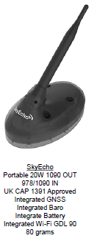
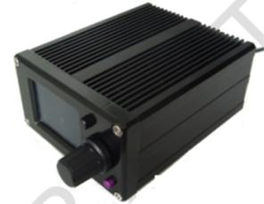
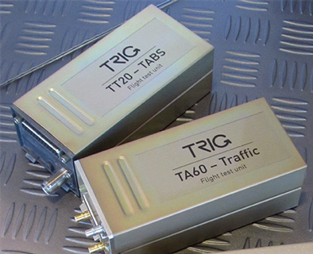
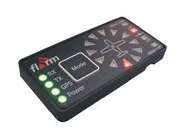
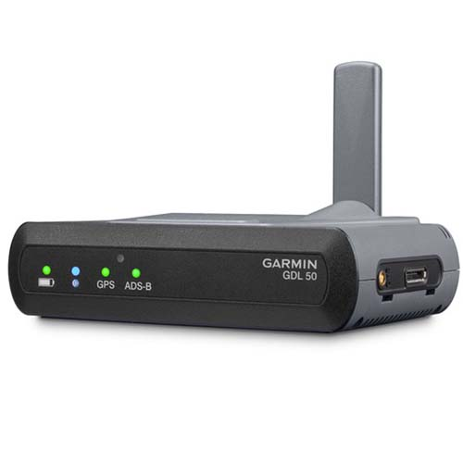
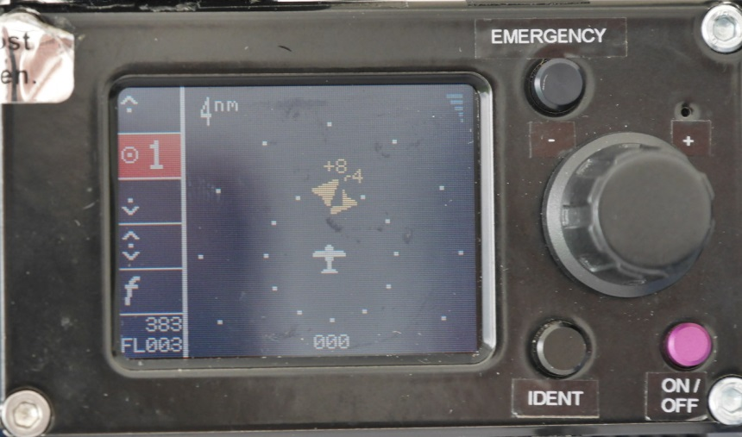
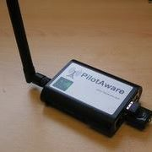
GA ADS-B Equipment. CAP1391 & more
CAP1391
Other 1090 MHz
Non 1090 MHz
Trig TABS & TSAA
FLARM & Power FLARM
Plane Sight
Garmin GDL 50
Pilot Aware
plus Extended Squitter capable Mode S transponders with GPS
Notes:
CAP1391 has spurred the development specifically of uAvionix Sky Echo.
The Project EVA LPAT has been updated to meet CAP1391, as well.
So the low cost market is potentially growing and low end GA is better catered for.
In the slightly higher end equipment market, prices are also dropping.
This slide shows some of the 1090MHz based ADS-B equipment that is available, as well as non-interoperable or partly interoperable equipment on different frequencies.
Suitable ADS-B equipment for your aircraft depends on
what you currently have (GPS, transponder etc)
certification regime you operate under
what you can afford
where you fly and therefore what you need

Slide 61
UK initiative 4: Project GAINS (Jan 2018-Dec 2019)
“General Aviation Improved Navigation & Surveillance” http://www.sesarju.eu/news/sesar-adapt-sat-based-technologies-general-aviation-operations
Surveillance Vision
Large scale demonstration of …
… interoperable Electronic Conspicuity for traffic situation awareness via ADS-B …
… for both cockpit environment and ground environment …
… affordable and usable for all (light) General Aviation …
… to improve safety and reduce airborne collision risk …
… especially in the aerodrome and near-aerodrome airspace …
… at all sizes of GA aerodromes …
… leading closer to the elusive complete known airspace air traffic environment
Notes:
The new project only just launched is GAINS = GA Improved Navigation and Surveillance.
AOPA leads the major part of this project.
I will talk only about the surveillance part.
The project has only just started and we are still developing the detailed planning but the aims of GAINS surveillance are to look at the possible end state of complete ADS-B equipage and its support to Electronic Conspicuity both airborne and ground, especially in the aerodrome environment.
Overall
What is different from current ops?
What is easier?
What is more difficult from both pilot and ground side of the operation?

Slide 62
GAINS coordination with UK CAA & NATS
Low density Low Complexity led by Highlands and Islands Airports Ltd (HIAL) – Mode S & ADS-B for mixed VFR/IFR environment
uAvionix/SkyDemon - weather data trial
CAA supported by NATS – simultaneous CAP1391 & Mode S transponder equipment operation
FASVIG run trial – Airfield traffic situation awareness
NATS – ADS-B supporting primary only infringement management
Electronic Conspicuity Development in Europe
Notes:
We are also coordinating with the UK CAA through the reactivated ECWG.
Here are some related projects that are in various stages.

Slide 63
EASA Electronic Conspicuity Forum 15th January 2018
CAP1391, plus growing interest in Electronic Conspicuity and increasing range of equipment led EASA to gather together UK, France, Germany, Garmin, Trig, FLARM, UK, France and Germany CAAs
No overall consensus, but many points of agreement.
Also several points of difference – work needed to resolve these.
Notes:
Final activity that I should like to mention is the awakening of interest from EASA, who invited all the European players to an “Electronic Conspicuity Forum” in January this year.
This showed that there is a lot of consensus and convergent thinking but also several things to dig into in more detail to resolve.
EASA is starting to become a more proactive regulator.

Slide 64
EASA EC Forum – points of agreement
Unaided see-and-avoid is not good enough as a means of conflict and collision avoidance
Electronic conspicuity is of value for GA air-air applications
Interoperability is needed in the implementation of EC
“Be seen” is of value as well as seeing other aircraft
Data quality requirements for GA traffic awareness applications do not need to be as demanding as for ATS separation applications
EC equipage in GA should be driven by benefit to the user
GA is price sensitive for discretionary purchases. Equipment needs to cost significantly under €1000? €500? less?
Notes:
The cost issue comes up again.

Slide 65
EASA EC Forum – points of difference and issues to solve
Is spectrum congestion an issue or not?
Interoperability: single or multiple datalinks? Common protocol and datalink? multiple receivers? rebroadcast techniques?
Data quality vs uptake: is some assurance of quality needed to avoid hazardously misleading info OR is any data better than none? Non-zero data quality drives up price and reduces manufacturers' options
Human factors. EC in the cockpit might distract and mislead so training is required OR pilots can work it out themselves: try it and learn from experience.
Find the right solution now; bad idea to spend and then find equipment is superseded OR deploy technologies that are partial solutions, so long as they are cost effective now. Users want something useful today, not perfection tomorrow.
Dominant ATS need for EC is CAT collision avoidance and infringement protection (ground based). ATS apps need high quality. But GA mainly wants avoidance of MAC, quality is already good enough.
Regulation. 1090ES in EASA aircraft should be based on high quality data (CS STAN) OR all EC equipment should be encouraged, even if lower data quality.
Notes:
I don’t want to mislead you. There are disagreements and strongly held differing opinions.
The main point is that they are being worked on collaboratively.

Slide 66
Where are we now?
Through the NATS initiative with AOPA and supported by SESAR, we have reached a position where lightly regulated EC equipment is on the market at a significantly lower cost than fully certified ADS-B.
Easier for GA to get into the EC environment.
But the story is not over.
Current equipment should be a step to better solutions.
Involvement of EASA may lead to Europe-wide acceptability and usage of GA Electronic Conspicuity along the lines of CAP1391.
Notes:
The theme of this session is “Technology and how it has advanced our flying”.
I have talked a lot about the technology – ADS-B.
There is a great deal about ADS-B that I haven’t mentioned – quality indicators, specific standards that already exist for CAT and their interoperability (or not) with the lower certification standards like CAP1391, interaction with TCAS and more. But that is a conference by itself.
The advancement in flying comes not directly from the technology but, instead, from the application of the technology, in this case to Electronic Conspicuity.
The way that I see it is
ADS-B = technology, including both ADS-B-IN and ADS-B-OUT
EC=application of ADS-B out, plus application of ADS-B-IN to display traffic in the cockpit.
But the primary technology is ADS-B-OUT because, without it, you can’t have ADS-B-IN.

Slide 67
Thanks for listening.
End

Slide 68
Glossary and Acronyms
ANC Air Navigation Conference (ICAO)
ANSP Air Navigation Service Provider
ATS Air Traffic Services
BGA British Gliding Association
BHPA British Hang Gliding & Paragliding Association
BMAA British Microlight Aircraft Association
CAA Civil Aviation Authority
CAP Civil Aviation Publication (UK)
CAT Commercial Air Transport
CRISTAL Co-opeRative ValidatIon of Surveillance Techniques and AppLications (Eurocontrol funded trials infrastructure)
DFS Deutsche Flugsicherung (German ANSP)
EASA European Aviation Safety Agency
EUROCAE European Organisation for Civil Aviation Equipment (Standards body)
Eurocontrol European Organisation for the Safety of Air Navigation
EVA Electronic Visibility by ADS-B
FAA Federal Aviation Administration
FLARM Flight Alarm (Glider Collision Warning Equipment)
GA General Aviation
,
GAINS General Aviation Improved Navigation & Surveillance
ICAO International Civil Aviation Organisation
LAA Light Aviation Association
LPAT Low Power ADS-B Transceiver
MAC Mid Air Collision
NATS National Air Traffic Services (UK ANSP)
NCO Non Complex Operation
RTCA USA Aviation Standards Organisation (equivalent to EUROCAE)
SC186 RTCA ADS-B Special Committee
SESAR Single European Sky ATM Research
SPI IR Surveillance Performance & Interoperability Implementing Rule (European “Mandate”)
TABS Traffic Awareness Beacon System
TSAA Traffic Situation Awareness with Alerts (EUROCAE/RTCA GA Collision Detection Application)
UAT Universal Access Transceiver
VDL4 VHF Data Link Mode 4
WAM Wide Area Multilateration
WG51 EUROCAE ADS-B WG

Slide 69
Electronic Conspicuity equipment to be used in
Project GAINS: PlaneSight & Sky Echo/Sky Demon

Slide 70
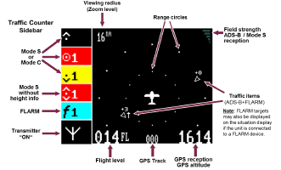
Plane Sight traffic display symbols

Slide 71
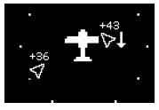
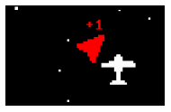
Plane Sight traffic display symbols
Traffic above and well clear
Threat traffic very close
Traffic above and well clear

Slide 72
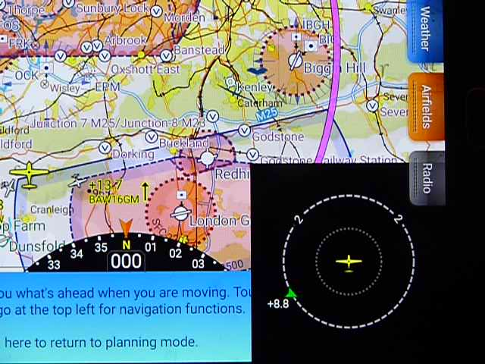
Sky Echo + Sky Demon display
Own
Aircraft
Overflying
aircraft
Overflying
aircraft
Sky Demon moving map nav display plus dedicated traffic display window
ADS-B data received by Sky Echo.

Slide 73
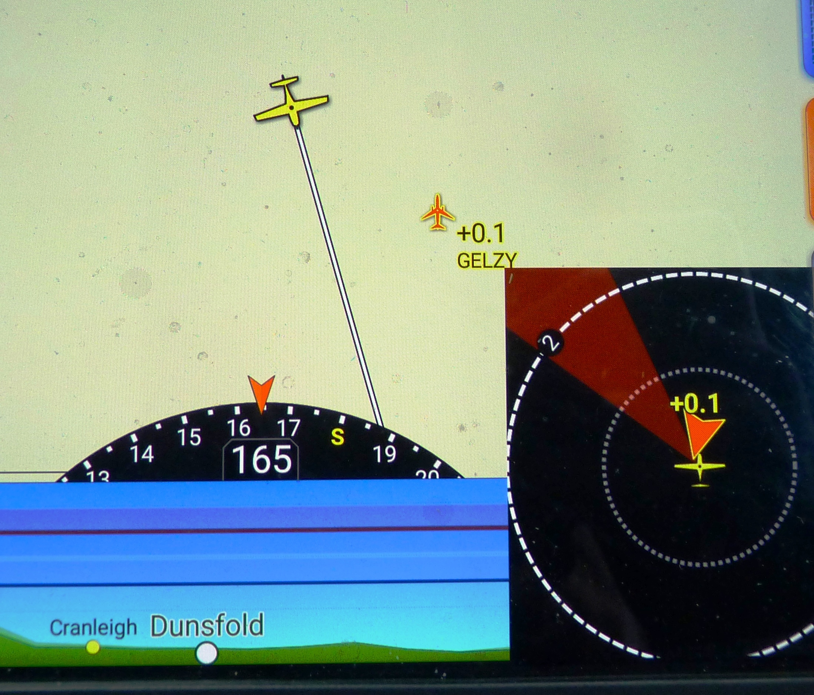
Sky Echo + Sky Demon display
Threat display on
traffic display window.
(Ground test)
Expanded scale navigation display

